Slide 1

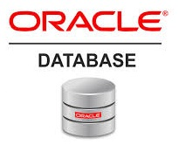
Oracle database
Lecture 52

Slide 2

Today’s Agenda
Introduction To Varray
Declaring & Initializing
Adding Elements
Accessing Elements
Example

Slide 3
Varray
VARRAY stands for the variable-sized array.
A VARRAY is single-dimensional collections of elements with the same data type.
Unlike an associative array and nested table, a VARRAY always has a fixed number of elements(bounded)

Slide 4
Declaring A Varray
To declare a VARRAY type, we use this syntax:
TYPE type_name IS VARRAY(max_elements) OF <data_type>;

Slide 5
Declaring & Initializing Varray Variable
Once we created the VARRAY type, we can declare a VARRAY instance of that type by referencing the VARRAY type.
The basic syntax for VARRAY declaration is:
varray_name type_name [:= type_name(...)];

Slide 6
Declaring & Initializing Varray Variable
To initialize a VARRAY variable to an empty collection (zero elements), we use the following syntax:
varray_name type_name := type_name();
If we want to specify elements for the VARRAY variable while initializing it, we can use this syntax:
varray_name type_name := type_name(element1, element2, ...);

Slide 7
Accessing A Varray
To access an array element we use the following syntax:
varray_name(n);
n is the index of the element, which begins with 1 and ends with the max_elements , that is the maximum number of elements defined in the VARRAY type.
If n is not in the range (1, max_elements), PL/SQL raises the SUBSCRIPT_BEYOND_COUNT error.

Slide 8
Example 1
DECLARE
TYPE weekdays IS VARRAY(7) OF VARCHAR2(3);
dow weekdays := weekdays ('Sun', 'Mon', 'Tue', 'Wed', 'Thu', 'Fri', 'Sat');
BEGIN
FOR i IN 1..weekdays.COUNT
LOOP
DBMS_OUTPUT.PUT_LINE (weekdays(i));
END LOOP;
END;

Slide 9
Exercise
WAP to fetch names of first 10 employees from the EMP table , store them in a varrayand then print them.

Slide 10
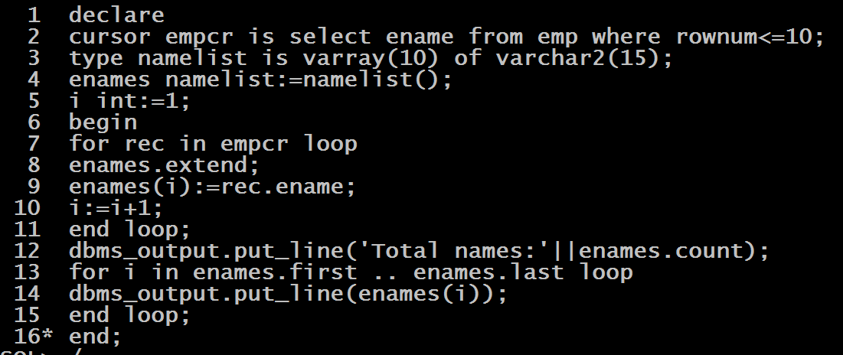
Solution

